Slide 1
Welcome to the AMALI Data Programme
[City]
[Date]

Slide 2
Welcome to the AMALI Data Programme
1
2
3
4
5
6
Introductions
Welcome to
the ADP
The ADP journey
Partnership logistics
Preparing for the 1st site
visit
Discussion & What’s Next?

Slide 3
Welcome to the AMALI Data Programme
1
2
3
4
5
6
Introductions
Welcome to
the ADP
The ADP journey
Partnership logistics
Preparing for the 1st site
visit
Discussion & What’s Next?

Slide 4
Let’s get to know each other
Who is in the room, and what excites you about your Mayor’s Legacy goal?

Slide 5

Meet Mawande, the AMALI Data Programme Lead
Mawande Ngidi has close to 15 years of experience supporting public sector leaders with strategic and data-driven decision-support to improve government delivery.
I began my career at the Council for Scientific and Industrial Research (CSIR) as a researcher focused on spatial analytics, supporting all spheres of government with data to inform planning and service delivery.
I then joined the Gauteng Premier’s Delivery Unit as Director of Research and Data Analysis, where I led teams in developing evidence-based plans and performance management across the infrastructure, health, and economic development sectors.
At Delivery Associates (DA), I served as a Senior Consultant, advising senior government leaders across Africa on strategic priority setting, delivery unit design, and embedding data-use in government systems. In Rwanda, I supported the definition of national priorities and the development of the Second National Strategy for Transformation (NST2), while also leading the establishment of a central Delivery Unit in the Prime Minister’s Office to drive national priorities; most notably, foundational learning reform with the Ministry of Education. I also supported the Ministry of Health in Lesotho to develop a digitisation policy aimed at integrating health information systems and strengthening the use of data for service delivery.
I hold a Master of Philosophy in Urban and Regional Science from Stellenbosch University and I’m joining the team as the AMALI Data Lead, where I’m supporting efforts to strengthen data systems and use across African cities

Slide 6
Meet [Jane / John Doe] your City Data Advisor
PLEASE ADD SHORT BIO

Slide 7
Welcome to the AMALI Data Programme
1
2
3
4
5
6
Introductions
Welcome to
the ADP
The ADP journey
Partnership logistics
Preparing for the 1st site
visit
Discussion & What’s Next?

Slide 8




Our goal is to empower city leaders and their teams take their data expertise to the next level
The AMALI Data Programme will support Mayors in delivering their legacy goal by providing direct coaching and tailored technical assistance to close data gaps, create a data reporting tool that allows for rigorous monitoring and evaluation of indicators, and creating a performance routine to use data in decision-making process.
Through AMALI Data Programme, cities will:
End Goal
Conduct a data inventory, identify data gaps and pilot efforts that will improve the city’s data infrastructure
Design and implement a data reporting tool that outlines goals and monitors performance indicators related to the mayor’s Legacy Goal
Develop and launch a data driven performance management routine within city hall focused on monitoring, evaluating, and communicating progress on their Legacy Goal to internal and external stakeholders.
Leaders will have an enhanced understanding of how to use data to make their city more effective, efficient, equitable, and accountable and of how leadership affects the conditions for success.
Data
Leadership
Performance Management
Data Reporting Tool
Starting point
Data Inventory & Quality Assessment

Slide 9
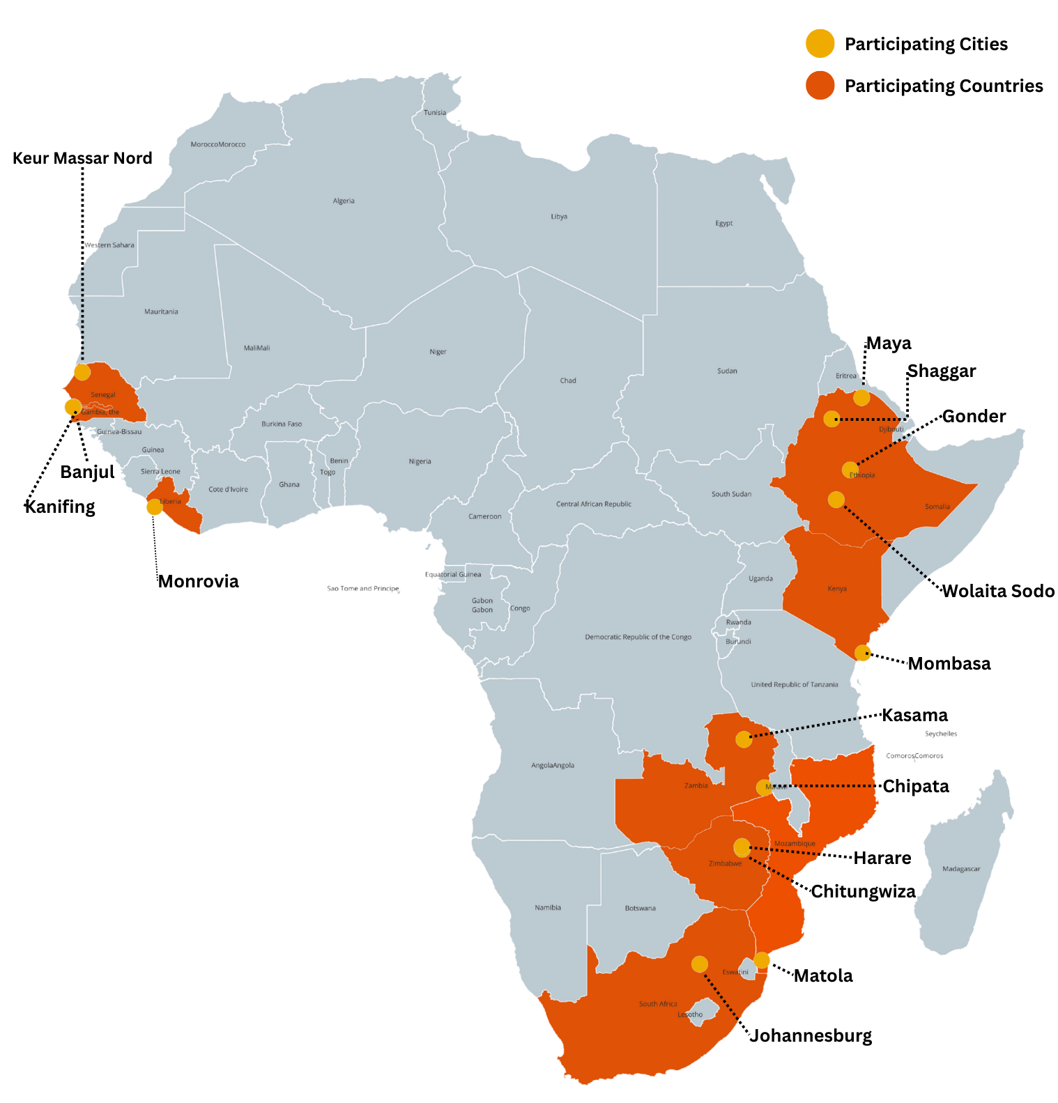



We received applications from 15 cities representing a combined population of ~18 million people
15
AMALI Data Programme Cities
Mayors & Governors
Ethiopia – Shaggar, Wolaita Sodo, Maya and Gandor
Kenya – Mombasa
Liberia – Monrovia
Senegal – Keur Massar Nord
South Africa – Johannesburg
The Gambia – Banjul and Kanifing
Zambia – Kasama, Chipata
Zimbabwe – Harare and Chitungwiza
Mozambique – Matola
9
Countries
4
Languages
18,310,201
Total Residents

Slide 10




Legacy goals range across 4 key themes
47% of the cohort is focused on improving city service delivery in one of the following areas:
Sanitation,
Housing,
Water,
Cleaning & Greening
7
on Service Delivery (cleaning & greening, solid waste management, water, development, housing)
5
on Urban Infrastructure (solar lighting, sewer system, renewable energy, road safety, storm water)
1
on Civic Engagement
2
on Youth Opportunities

Slide 11
Welcome to the AMALI Data Programme
1
2
3
4
5
6
Introductions
Welcome to
the ADP
The ADP journey
Partnership logistics
Preparing for the 1st site
visit
Discussion & What’s Next?

Slide 12

Mayor Morero’s goal
To reclaim, restore and rebuild the inner city of Johannesburg (city centre) by 2026

Slide 13
Engagement journey
Feb
March
April
May
Jun / Jul
Aug
Sept
Oct
Nov
Dec
Application
Informational Interviews
City selection and notification
City Welcome Calls + Coaching & Technical Assistance begins
Data Inventory launched
City visit 1
Reporting Tool Designed and Launched
Performance Management Routine Launch
City visit 2
AMALI Reunion
Wrap up
Aftercare

Slide 14




Support Provided in the Programme
Weekly Coaching & Technical Assistance sessions
2 In-Person Site Visits & Trainings
Standing Office Hours
Access to Self-Guided Resources and Best Practices
City Data Advisors will provide coaching and technical assistance with deep knowledge on the technical aspects of collecting, managing, and utilizing data with a close understanding of local context
In-city site visits offer personalized guidance and expertise tailored to the unique needs of each municipality. These visits provide an invaluable opportunity for hands-on collaboration, allowing coaches to work directly with city officials to assess challenges, explore innovative solutions, and develop actionable strategies focused on connecting data to the legacy goal.
The City Data Advisors, Program Director and Urban Governance Research Lab will support on a demand-driven format to cities in need of further support
Cites will have access to self-guided courses and on-demand resources to further enhance their data practices at their own pace.

Slide 15
Engagement Learning Journey
Getting Started with Data Management (June) | Designing an Effective Data Reporting Tool (August) | Launching and Sustaining a Performance Management Routine (September)
Key Data Concepts: Data Inventory Availability of Data Quality (methods) Closing Data Gaps | Key Data Concepts: Data Reporting Tool Developing Goals Selecting Performance Metrics Establishing Targets | Key Data Concepts: Performance management Analytics Communicating progress to internal and external stakeholders
Resources: Video Best practices | Resources: Video Best practices | Resources: Video Best practices
Key learning objectives: Learn the meaning of data management and how organization practice it Recognize issues that data management practices can address Know the foundational data management practices | Key learning objectives: Learn the importance of effective data reporting Recognize how to identify the right metrics and targets Learning foundation of how to establish a data reporting process | Key learning objectives: Identify the components of successful performance management processes Recognize tools to get started with and sustain performance management practices Learning the importance of communicating progress to internal and external stakeholders by utilizing data

Slide 16
Working with your City Data Advisor
Coaching Values
Technical Assistance
City Data Advisors bring trusted, flexible, and values-driven support to city teams
Convener / Facilitator
Confidante / Sounding Board
Integrator
Flexible
Subject-Matter-Expert
Accountability Partner
City Data Advisors will provide technical support to assist cities by:
Co-developing a tailored data inventory template
Creating a practical data reporting tool
Guide the development of documented performance management framework
Support launch of your performance management routine

Slide 17
Welcome to the AMALI Data Programme
1
2
3
4
5
6
Introductions
Welcome to
the ADP
The ADP journey
Partnership logistics
Preparing for the 1st site
visit
Discussion & What’s Next?

Slide 18
The programme delivers real impact when the city’s leadership and project team is fully engaged
City Project Team responsibilities
Attend all engagement meetings
Meet internally as a team to discuss key concepts, make decisions, prepare for on-site visits, and complete deliverables
Engage with City Data Advisor and be prepared with questions
Complete all Deliverables
Piloting Data Inventory
Launching Data Reporting Tool
Conducting 1st Performance Meeting
1
2
3
4

Slide 19
Role of the city team during weekly engagement calls
City Data Project Team will meet with the City Data Advisor weekly
City team to establish the best time and date per week for these discussions (recurring schedule to be sent after this meeting)
Provide secretariat support; minutes/ note taking/ reporting (in some aspects this will be in collaboration with the ADP team)
Meetings will be recorded for record keeping
A Google shared drive will be created for all parties to upload information and work transparently
ADP team will review submissions and derive questions from these information pieces.
1
2
3
4
5

Slide 20
We understand that the current core project team will consist of these key city members
Team Member The name of the team member | Role in the city Portfolio the team member oversees in the city | Project Role Role team member will be playing in the AMALI Data Programme - To be completed in subsequent engagements)
XX
XX
XX
XX
XX

Slide 21
Welcome to the AMALI Data Programme
1
2
3
4
5
6
Introductions
Welcome to
the ADP
The ADP journey
Partnership logistics
Preparing for the 1st site
visit
Discussion & What’s Next?

Slide 22
Site visit schedule
City | City Visit dates
Harare | Mon–Tue, Jun 16–17
Chitungwiza | Wed–Thu, Jun 19–20
Johannesburg | Mon–Tue, Jun 23–24
Kasama | Wed–Thu, Jun 25–26
Banjul | Mon–Tue, Jun 30–Jul 1
Kanifing | Wed–Thu, Jul 2–3
Monrovia | Mon–Tue, Jul 7–8
Keur Massar | Thu–Fri, Jul 10–11
Shaggar (Addis) | Mon–Tue, Jul 14–15
Wolaita Sodo | Wed–Thu, Jul 16–17
Mombasa | Mon–Tue, Jul 21–22

Slide 23
How to prepare for 1st Site Visit?
Planning / Logistics
Confirm city project team members who will join the city visit
Confirm a date for 1st In-City visit (2 day visit) beginning June 16 to June 23 July.
Review and approve invitation letter
Arrange venue and catering requirements
Choose site(s) to visit on Day 2.
Prepare an update on the legacy goal
Review Materials / Deliverables
Optional Getting started with data management Course - Link
Optional Getting Started with Performance Analytics Course - Link
Complete All Deliverables assigned by City Data Advisor

Slide 24
Welcome to the AMALI Data Programme
1
2
3
4
5
6
Introductions
Welcome to
the ADP
The ADP journey
Partnership logistics
Preparing for the 1st site
visit
Discussion & What’s Next?

Slide 25
Results of baseline assessment (1/3)

Slide 26
Results of baseline assessment (2/3)

Slide 27
Results of baseline assessment (3/3)

Slide 28
Welcome to the AMALI Data Programme
1
2
3
4
5
6
Introductions
Welcome to
the ADP
The ADP journey
Partnership logistics
Preparing for the 1st site
visit
Discussion & What’s Next?

Slide 29
Discussion Questions
What has the City team been doing since the last meeting held with the ADP team?
How often has the team met since the last discussion?
Are there any significant shifts taking place in terms of the Mayor’s legacy goal?
Has the City team run an internal process to obtain the necessary approvals (through the applicable committees/Exco/Mayoral Committee?)
Have the affected communities been notified of the legacy goal and the intended programme work to be conducted?
Do any members of the communities affected by this work form part of the meetings the City holds?

Slide 30
What’s Next?
Commencement of weekly engagements
Stakeholder Mapping
SWOT Analysis
Developing a Project Scope of Work
Preparing for the upcoming site visit

Slide 31
For any queries please contact:
Mawande Ngidi
Mawande.ngidi@uct.ac.za
+27 66 302 1969

Slide 32
Danko!!!

